Slide 1
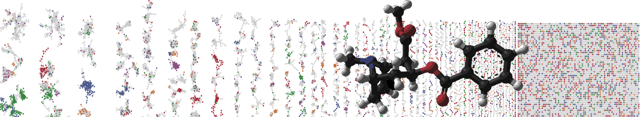


GNPS Polarity Merging for Molecular Networking
Hands On
Allegra Aron
Alan Jarmusch
Mingxun Wang
University of California - San Diego

Slide 2
GNPS Documentation
Classical Molecular Network
https://ccms-ucsd.github.io/GNPSDocumentation/networking/
Feature Based Molecular Networking
https://ccms-ucsd.github.io/GNPSDocumentation/featurebasedmolecularnetworking/
Merge Network Polarity
https://ccms-ucsd.github.io/GNPSDocumentation/mergepolarity/

Slide 3
What do we need?
Positive Molecular Network Job
https://gnps.ucsd.edu/ProteoSAFe/status.jsp?task=0834479d2e2c487994aa6f68253a209d
Negative Molecular Network Job
https://gnps.ucsd.edu/ProteoSAFe/status.jsp?task=a40b5a63ef4d4e16830a7293f5a3181f

Slide 4
Merged Network
https://gnps.ucsd.edu/ProteoSAFe/status.jsp?task=f5f337e18af449c296e951b1d047e823

Slide 5
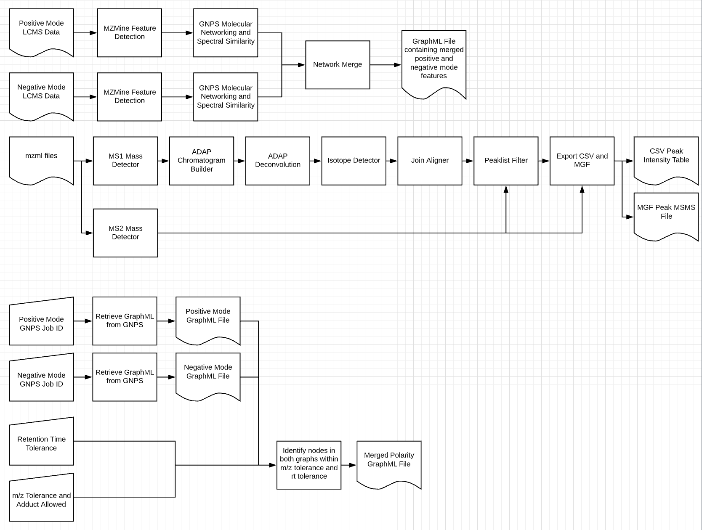
Polarity Merging Workflow - Theory

Slide 6
Polarity Merging Workflow - Theory

Slide 7
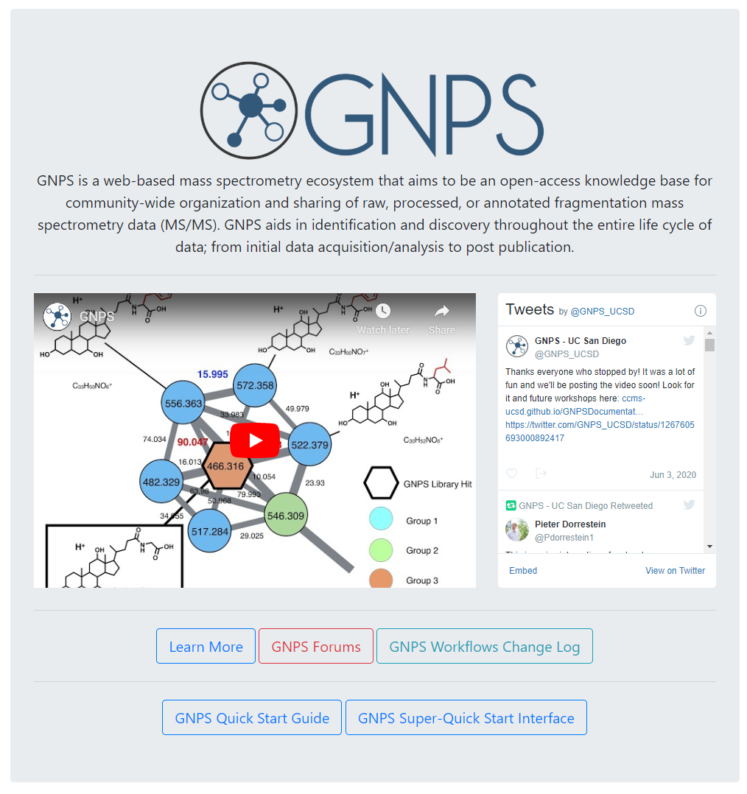
Go to gnps.ucsd.edu
Create GNPS Account
Click on Learn More

Slide 8
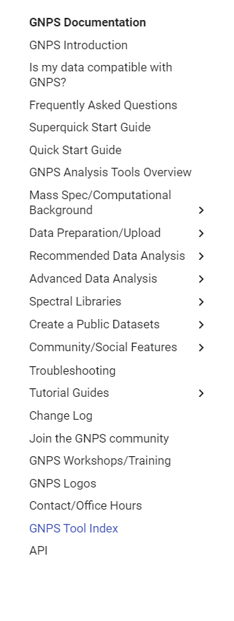
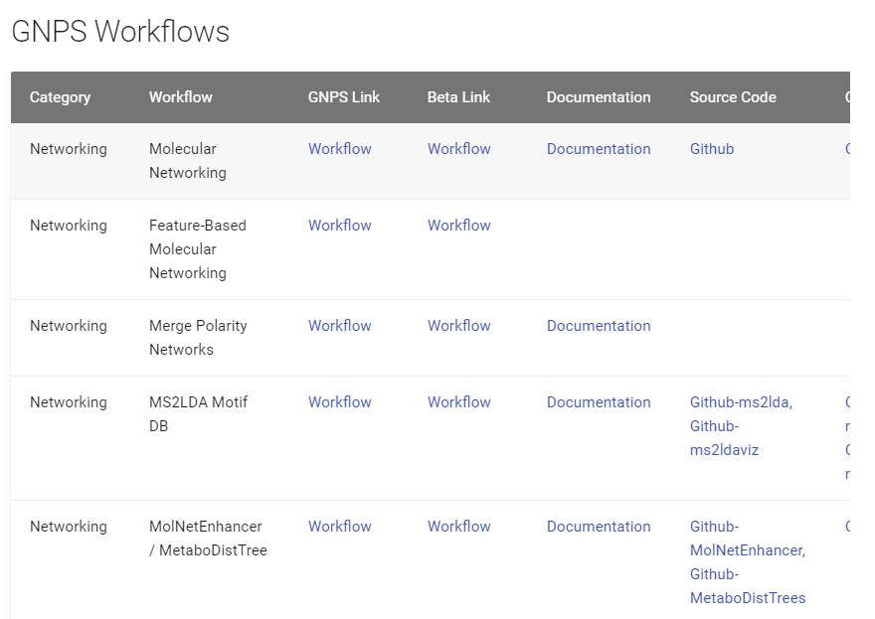
Go to Tool Index
Find Merge Polarity Networks
Link

Slide 9
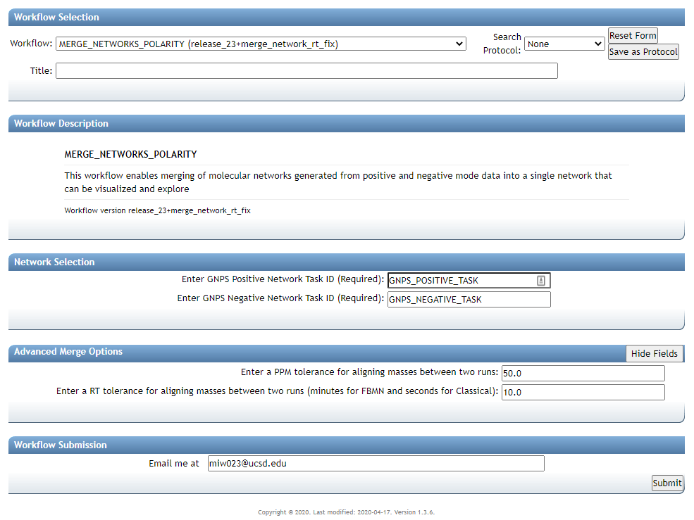

Slide 11
Positive Molecular Network Job
https://gnps.ucsd.edu/ProteoSAFe/status.jsp?task=0834479d2e2c487994aa6f68253a209d
0834479d2e2c487994aa6f68253a209d

Slide 12
Negative Molecular Network Job
https://gnps.ucsd.edu/ProteoSAFe/status.jsp?task=a40b5a63ef4d4e16830a7293f5a3181f
a40b5a63ef4d4e16830a7293f5a3181f

Slide 13
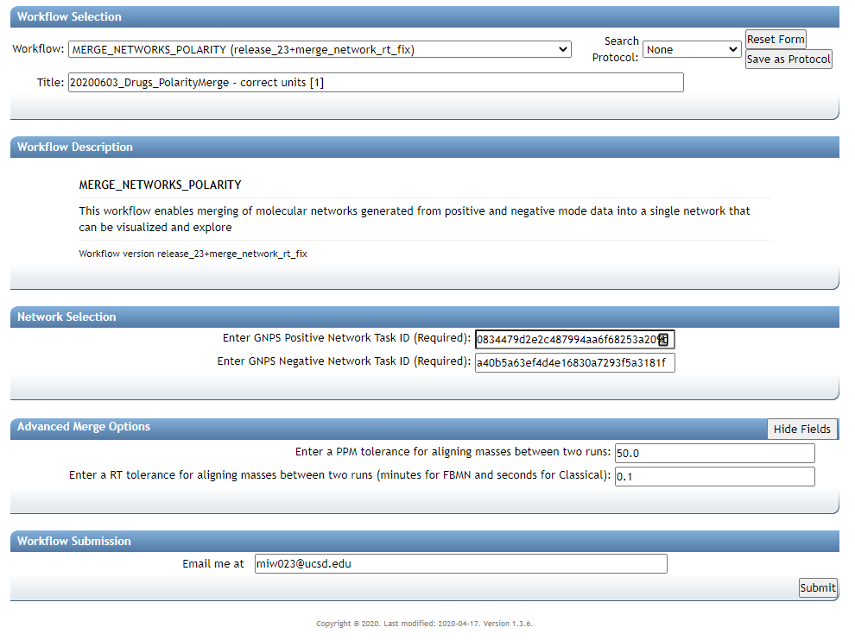
FBMN – in minutes
Classical Network - seconds

Slide 14
Add Email
Submit Network

Slide 15
Merged Network
https://gnps.ucsd.edu/ProteoSAFe/status.jsp?task=f5f337e18af449c296e951b1d047e823

Slide 16
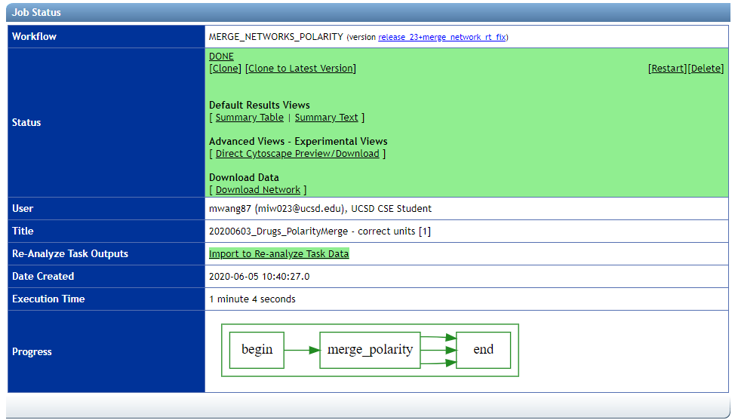

Slide 18
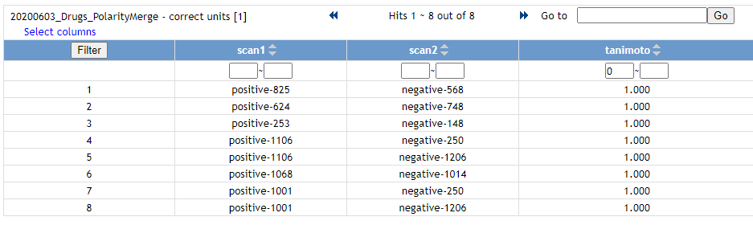
Check Quality of Merging

Slide 20
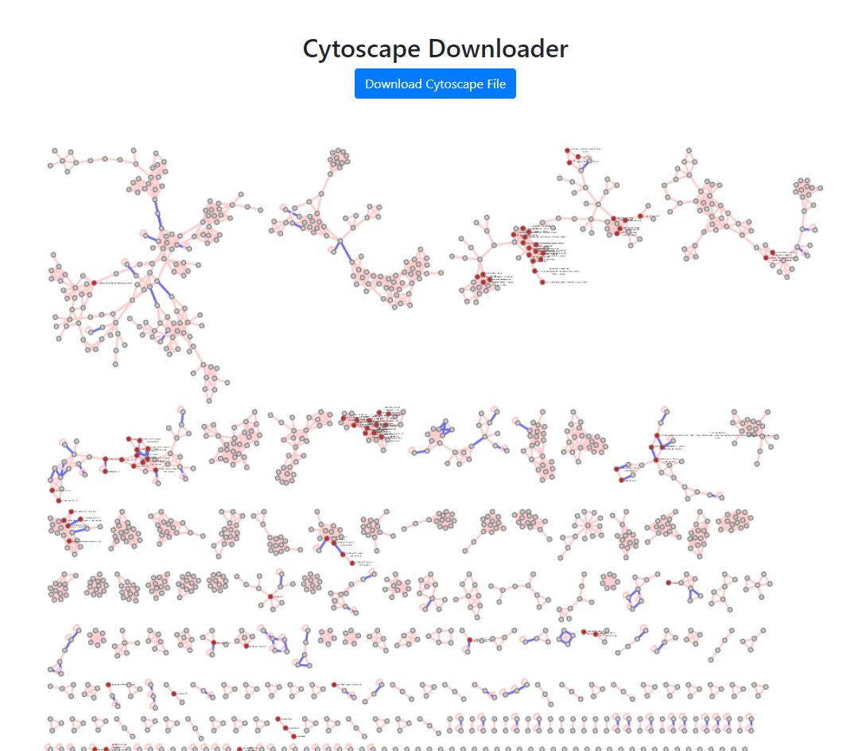
Blue Edge – Polarity Edge
Red Nodes - Identified
Link

Slide 21
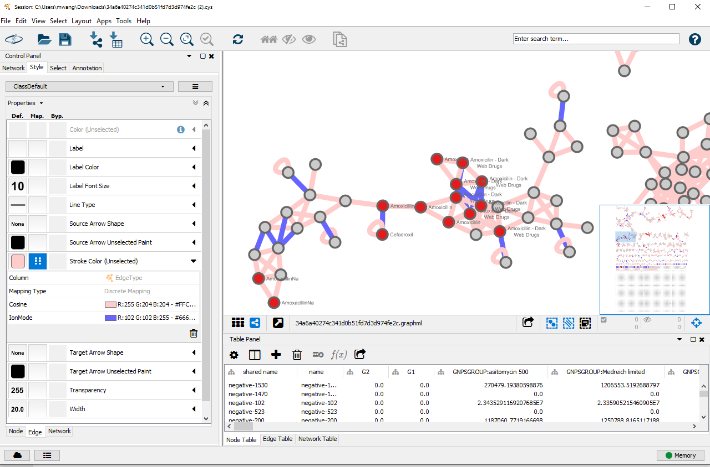
Explore your Molecular Network in Cytoscape

Slide 22
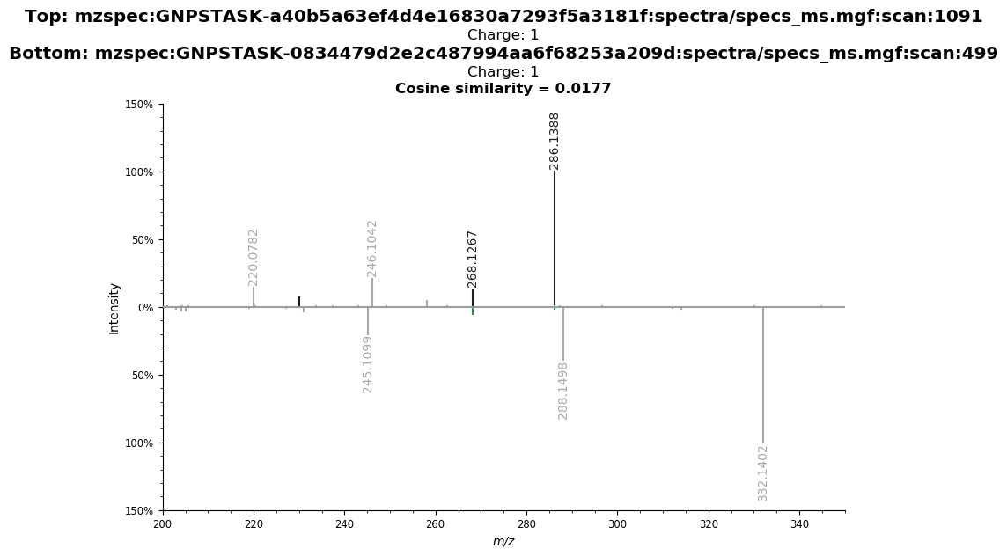
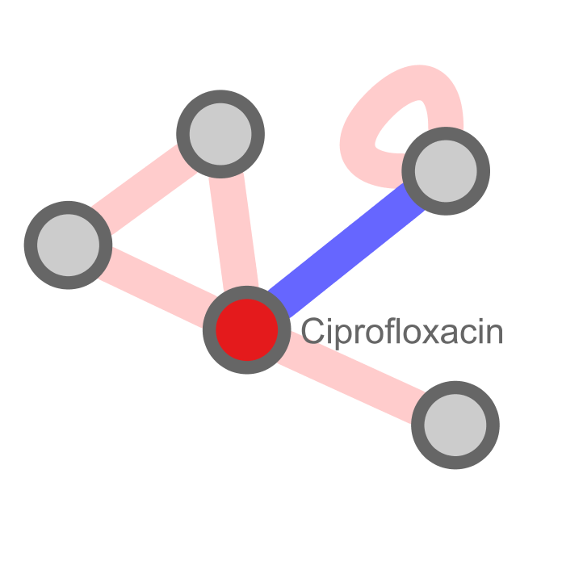
Example Of Cross Annotation
Negative mode unidentified, but can propagate from Positive
USI Link

Slide 23
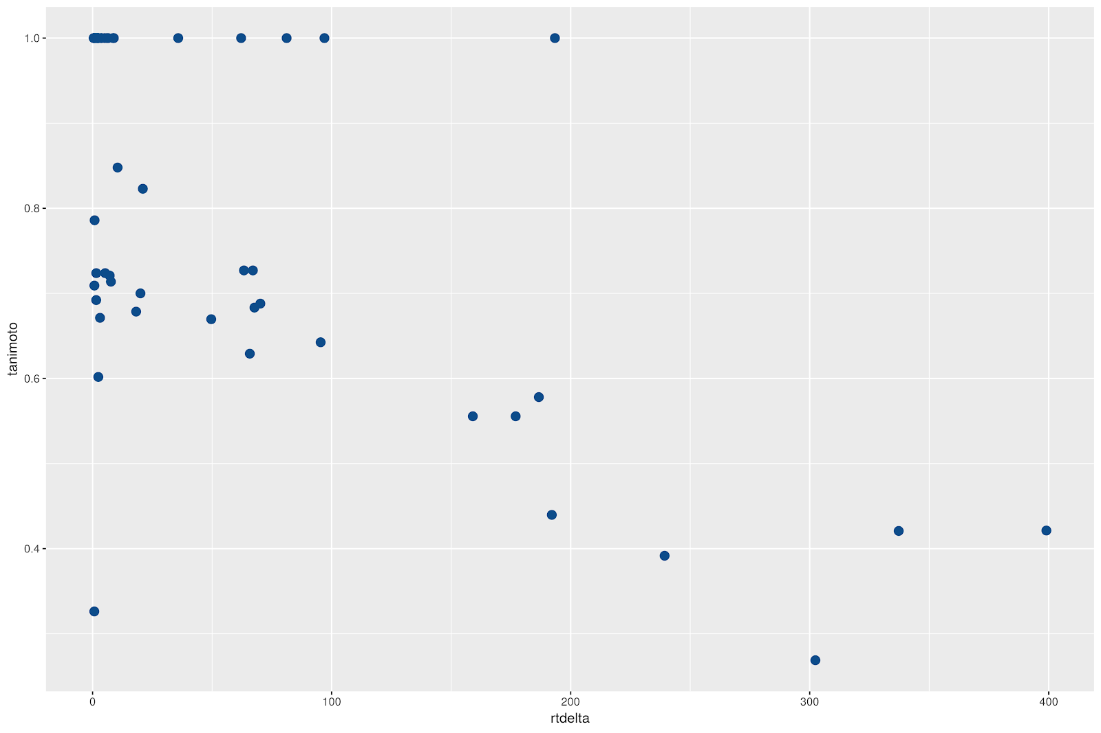
Exploring relationship between RT delta and correct structure

Slide 24
Questions, Problems or Bugs?
Documentation: https://ccms-ucsd.github.io/GNPSDocumentation/
Forum: https://groups.google.com/forum/#!forum/molecular_networking_bug_reports
Allegra Aron
Alan Jarmusch
Mingxun Wang

